Slide 1
Emotion Recognition in Text: A Beginner's Approach
Md. Abu Hasnat (011221436)
Atique Bin Mahmud(011221444)
Ilham Mahfuz Riyadh (011221521)
Nafis Nawal (011221549)

Slide 2
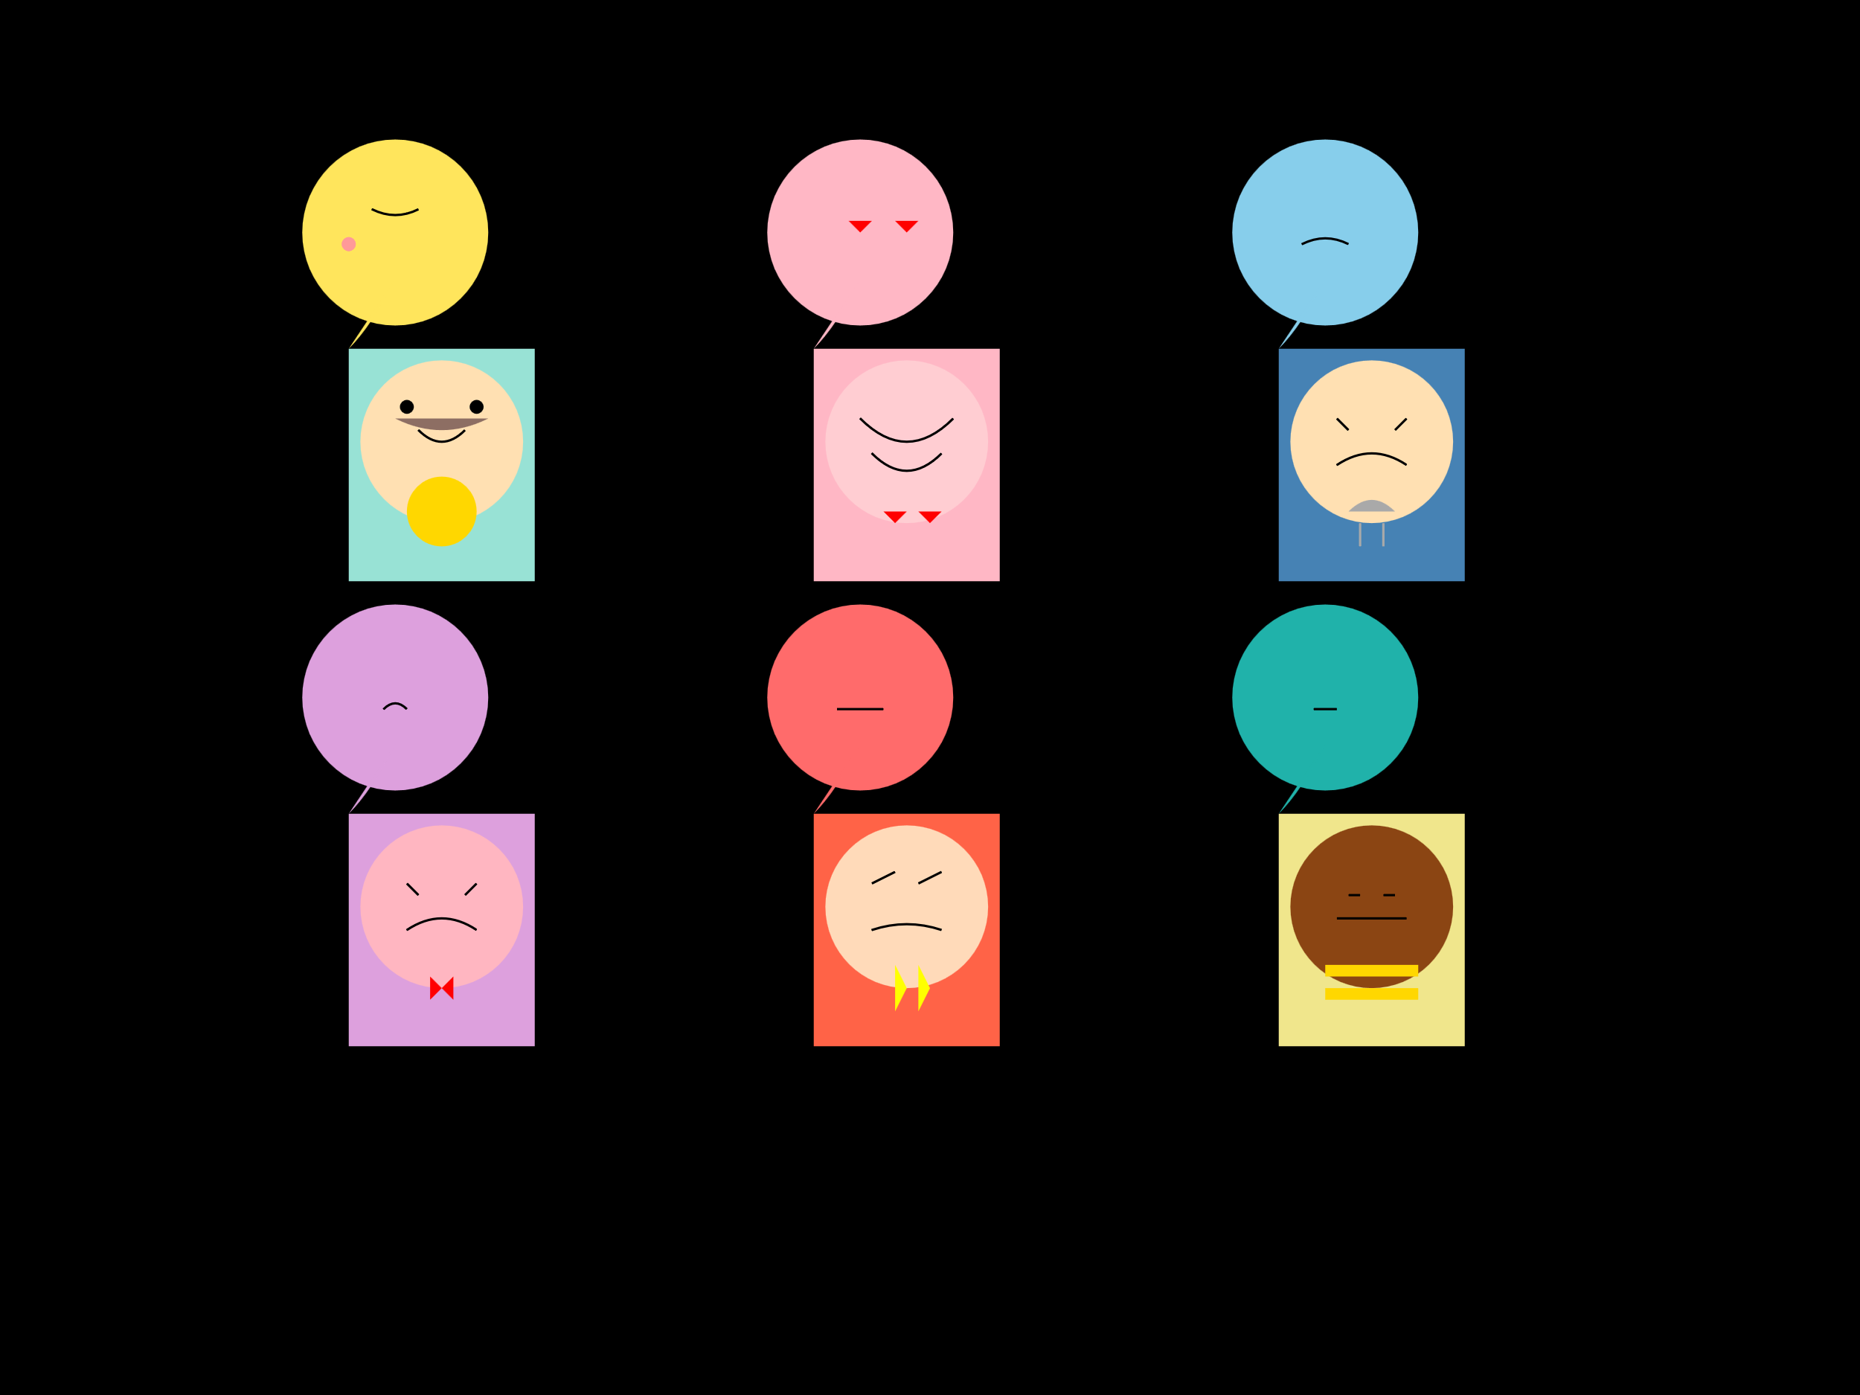
Sequence of Presentation
Introduction
Previous Research Works
Research Gap
Motivation
Dataset
Proposed Machine Learning Model
Performance Comparison
Conclusions

Slide 3
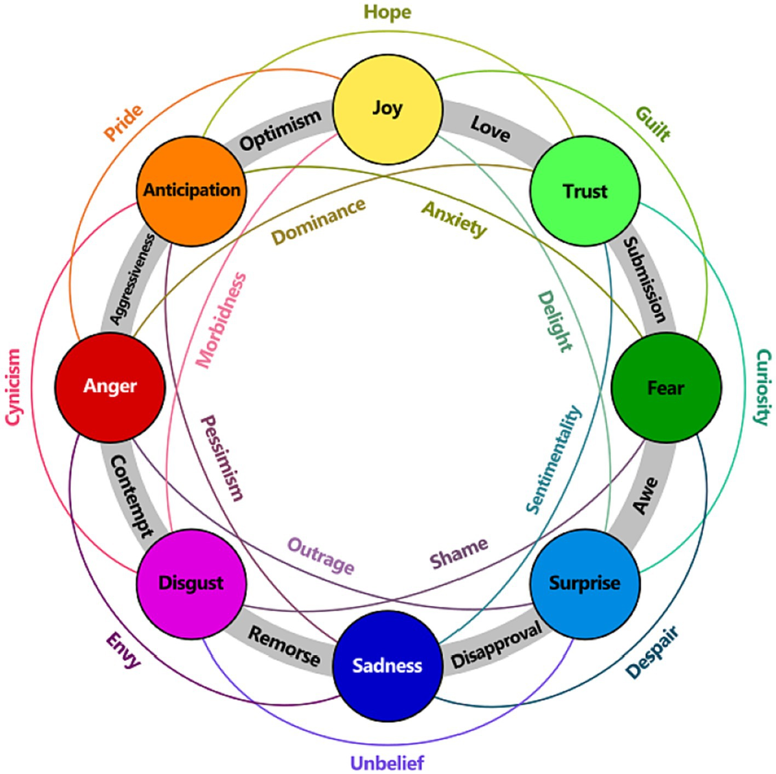
Introduction
What is Emotion Detection?
Significance
Objective
Challenges

Slide 4
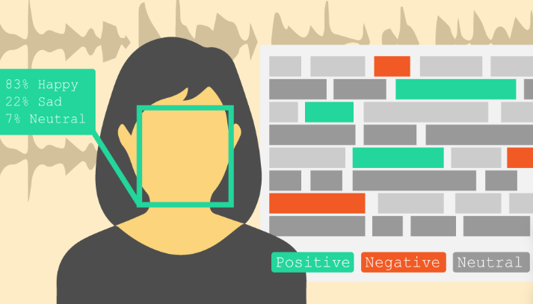
Previous Research Works
Overview of Research:
Emotion detection from text has evolved significantly, from rule-based methods to modern deep learning techniques.
Traditional Approaches:
Early studies relied on rule-based methods using predefined linguistic patterns.
Machine learning models like Naive Bayes and SVM with feature extraction techniques (e.g., TF-IDF) were commonly used.

Slide 5
Previous Research Works
Modern Advancements:
Deep learning models such as LSTMs and CNNs improved accuracy by capturing sequential and contextual information.
Pre-trained models like BERT and GloVe revolutionized emotion detection by leveraging massive text corpora.
Limitations in Prior Research:
Lack of large, diverse datasets for training robust models.
Difficulty in detecting subtle or ambiguous emotions.
Limited generalization to real-world applications due to domain-specific training.

Slide 6

Research Gap
Observed Gaps in Existing Research:
Lack of accurate models for detecting subtle and overlapping emotions.
Over-reliance on specific datasets that lack diversity in text types and emotional expressions.
Limitations of Traditional Approaches:
Poor performance in handling ambiguous or complex emotional expressions.
Limited scalability of rule-based and traditional ML models for larger datasets.
Unaddressed Challenges:
Need for better generalization across different text domains (e.g., social media vs. formal text).
Integration of context-aware models to enhance emotion detection accuracy.

Slide 7
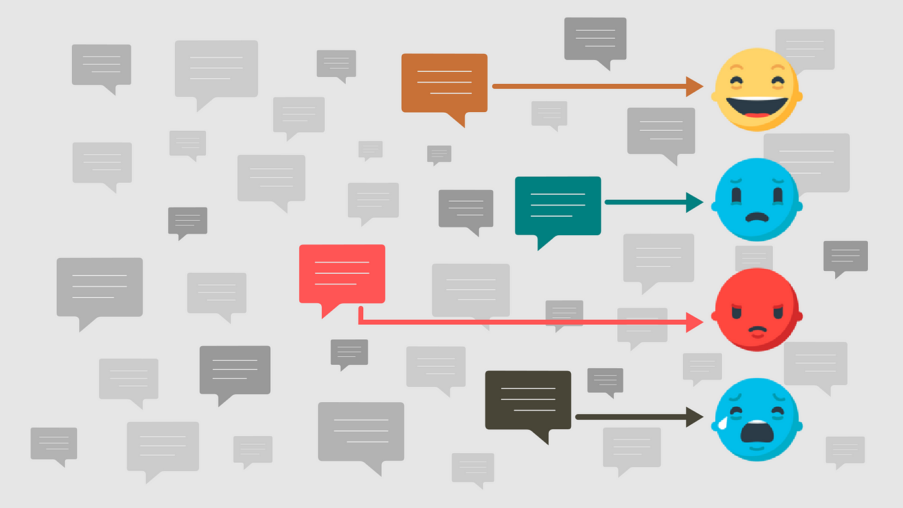
Motivation
Importance of Emotion Detection:
Critical for understanding human behavior and improving human-computer interactions.
Widely applicable in fields such as mental health, customer service, and social media analysis.
Practical Applications:
Enhance sentiment analysis for businesses to improve customer experience.
Support mental health monitoring by detecting emotional distress in textual communication.
Aid in content moderation by identifying harmful or offensive emotions

Slide 8
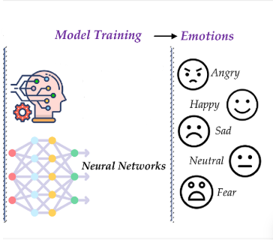
Motivation
Why This Problem?
Growing volume of text data from digital platforms creates a need for scalable solutions.
Existing models fail to accurately capture the nuances of emotions in text.
Personal/Academic Interest:
Passion for applying machine learning to solve real-world NLP challenges.
Opportunity to contribute to advancing research in emotion detection.

Slide 9
Dataset
Dataset Overview:
Size: 839,555 entries.
Columns:
text: Contains text data (e.g., tweets, sentences).
Emotion: Emotion labels such as anger, joy, sadness, neutral, etc.
Key Characteristics:
Text data includes diverse emotional expressions, providing a rich resource for training machine learning models.
Multiple emotion categories allow for fine-grained analysis.

Slide 10
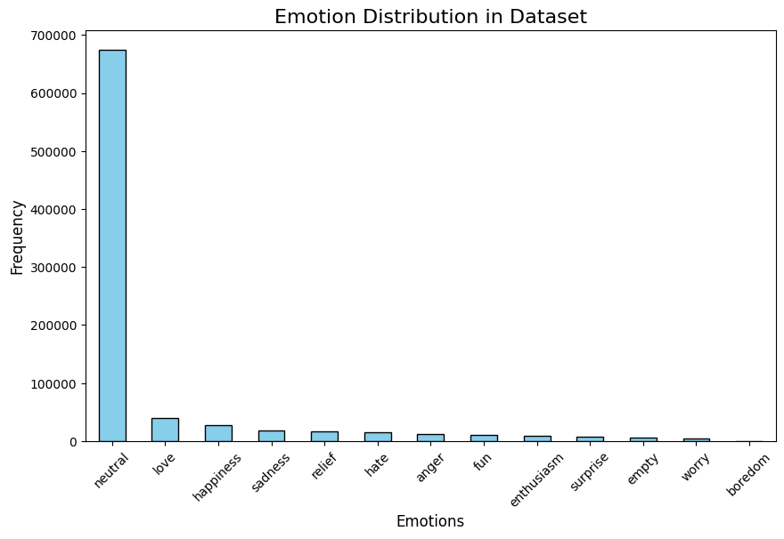
Dataset

Slide 11
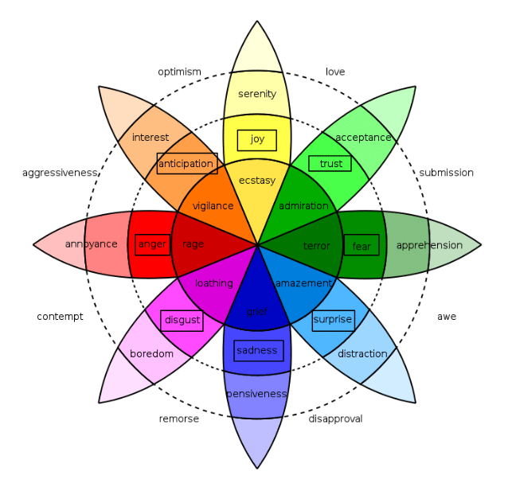
Dataset
Emotion Distribution:
Most Common Emotions: (e.g., neutral, joy, sadness).
Visual representation through a bar chart or similar to highlight the
proportion of each emotion class.
Preprocessing Steps:
Removed unnecessary columns
Converted text to lowercase for uniformity.
Removed punctuation and stopwords to focus on meaningful words.
Tokenized the text for feature extraction.

Slide 12
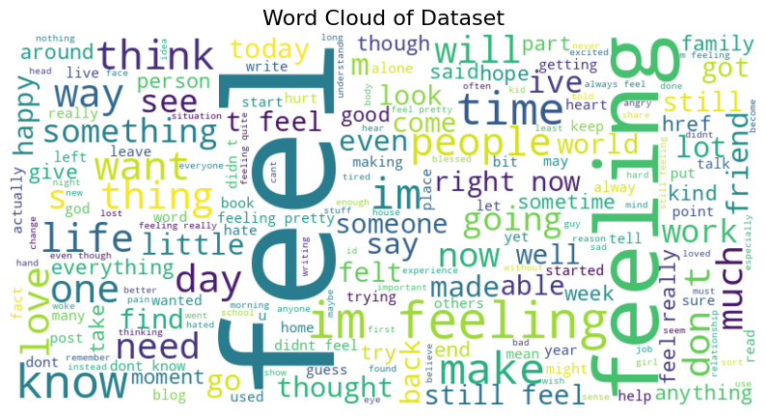
Dataset

Slide 13
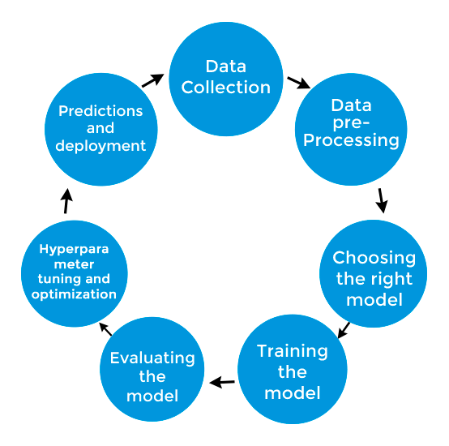
Proposed Machine Learning Model
Overview of the Approach:
Utilized traditional machine learning algorithms:
Logistic Regression
K-Nearest Neighbors (KNN)
Support Vector Machines (SVM)
Compared performance across models to determine the best fit.
Key Features of the Models:
Logistic Regression:
Simple and interpretable baseline model.
KNN:
Non-linear model capturing relationships between text samples.
SVM:
Robust to overfitting and effective for high-dimensional spaces.

Slide 14
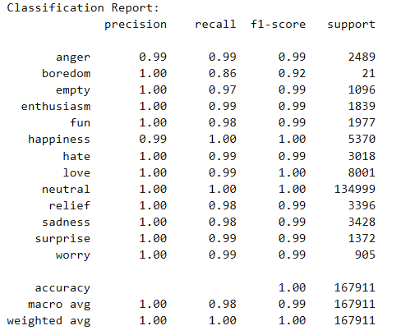
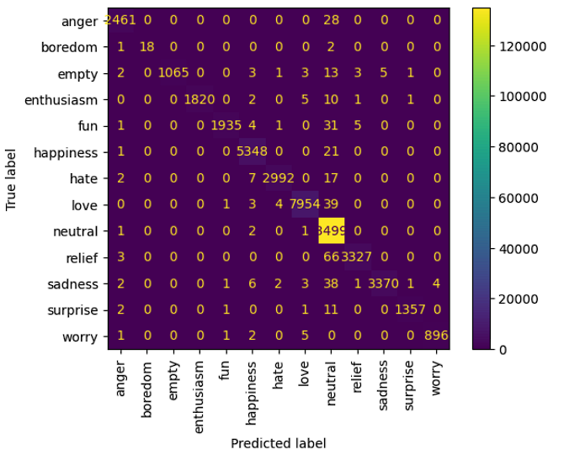
Performance Comparison (Logistic Regression)

Slide 15
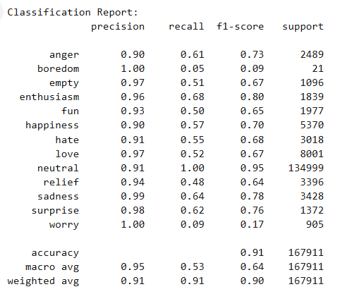
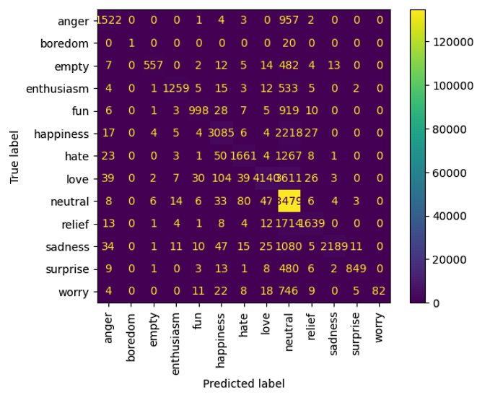
Performance Comparison (KNN)

Slide 16
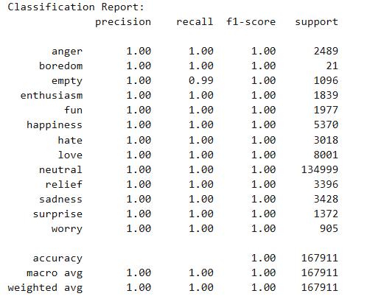
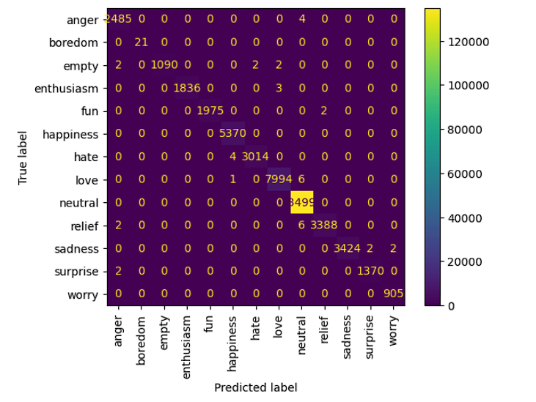
Performance Comparison (SVM)

Slide 17
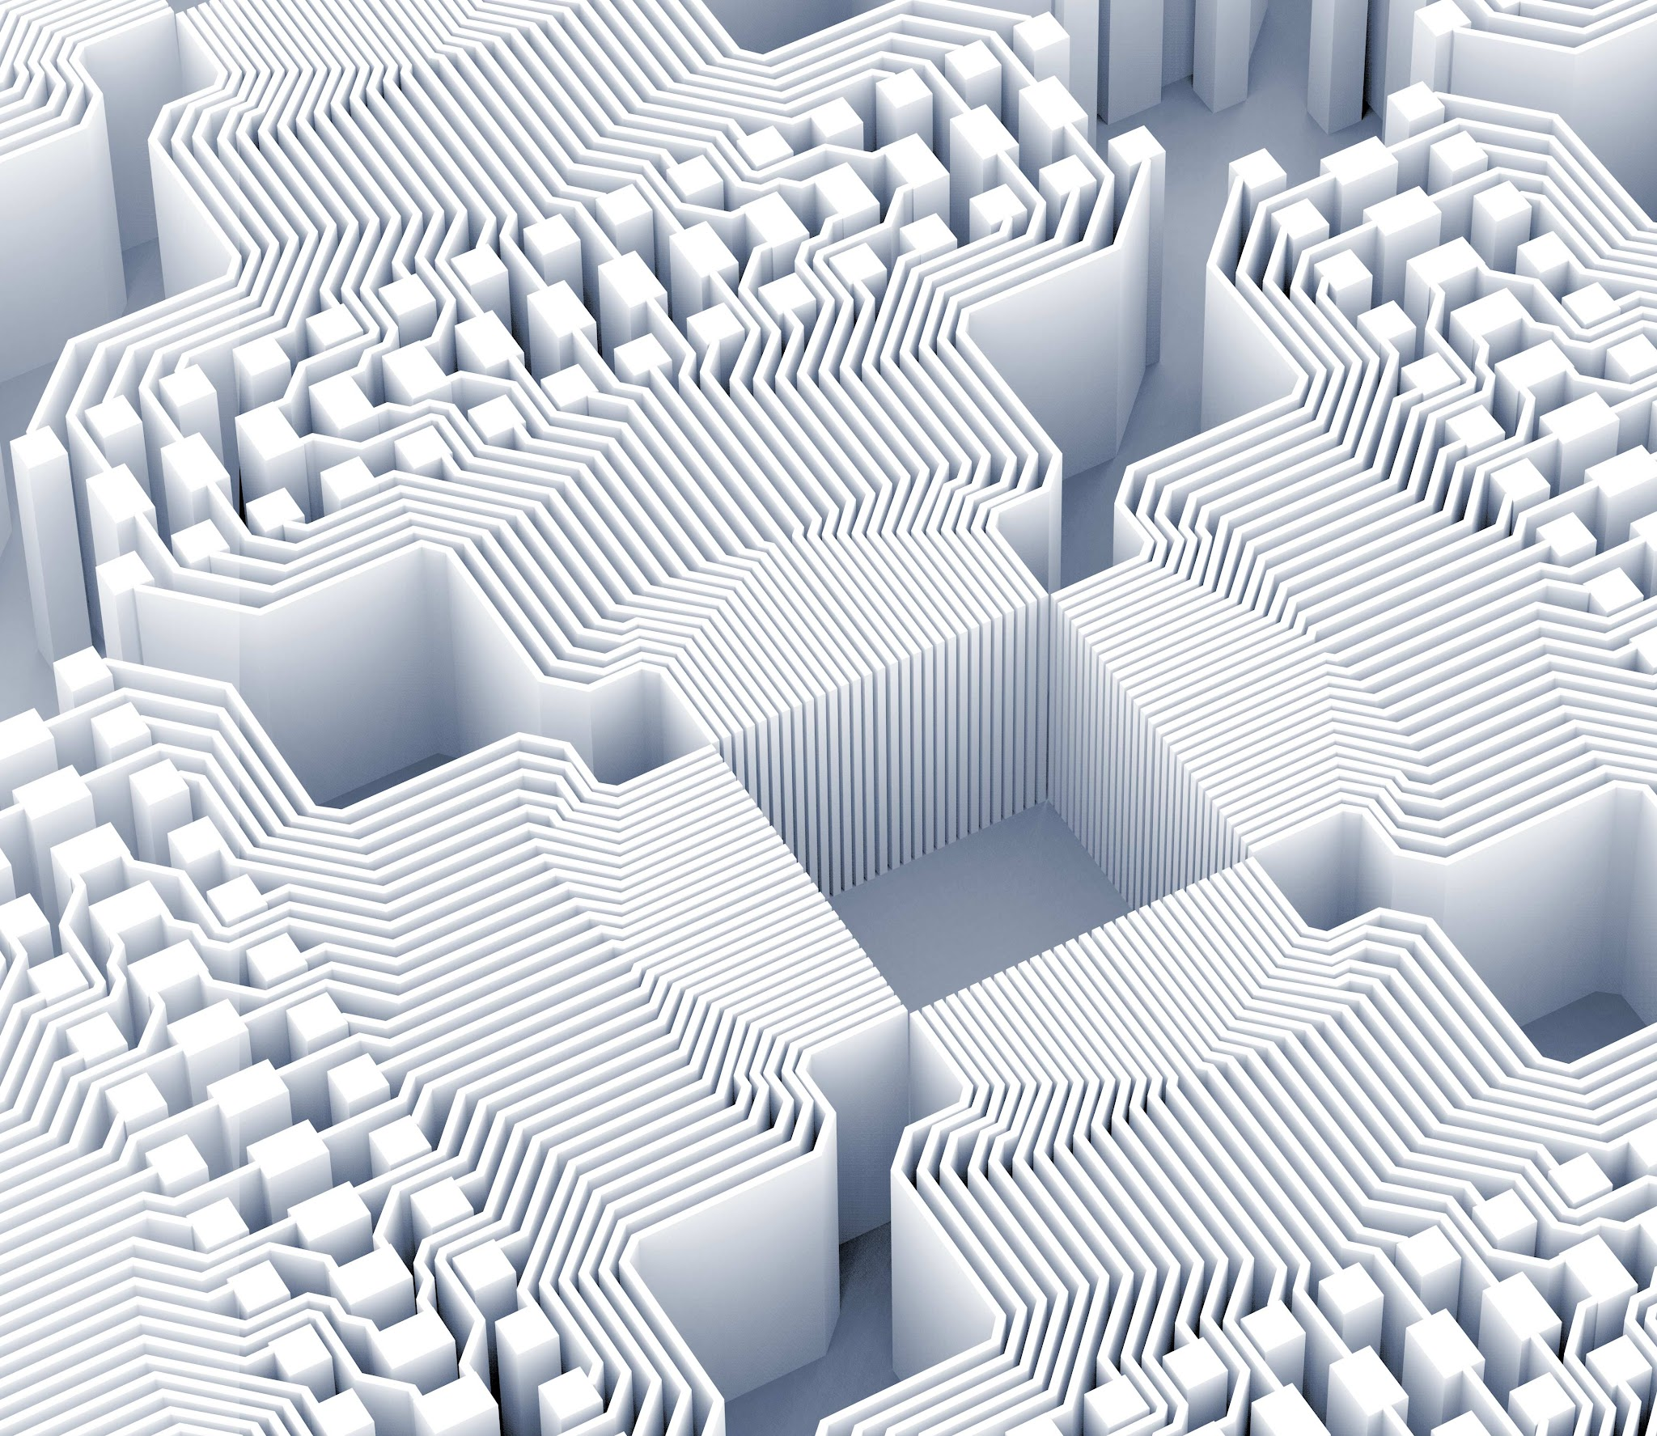
Thank you!

